Slide 1
TimeClock Plus Basics
for all Employees and Supervisors
Presenter: Michelle Garcia & Sonya Moreno

Slide 2
Contents
Clocking in and out operations
Missed punches
Correct/revise punch
Requesting Leave
Deleting a Leave Request
Verifying Time
Electronic Time Adjustment Request (TARF) - PowerApps
Time Adjustment Request Form
Best Practices

Slide 3
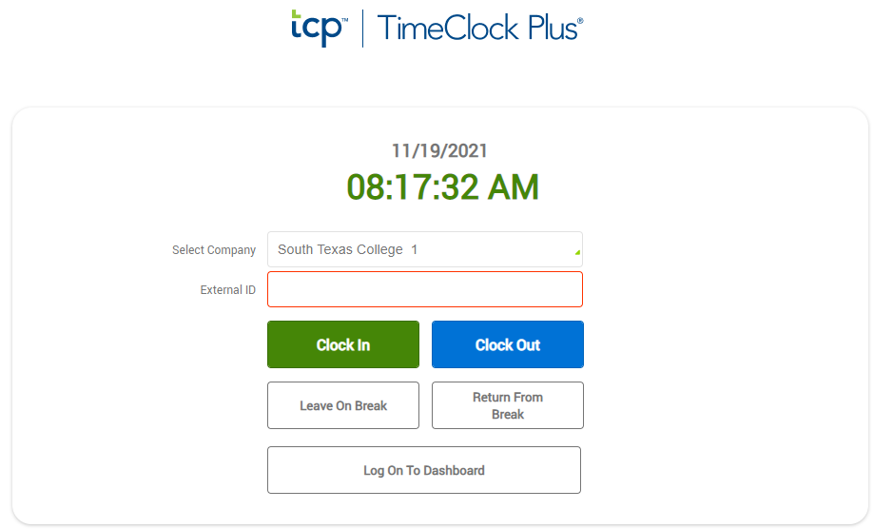
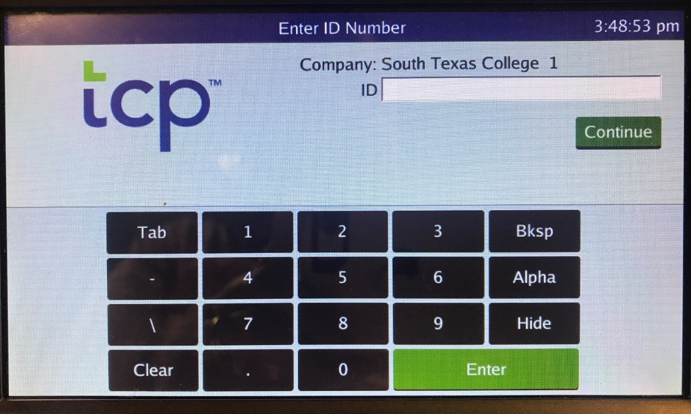
Clocking in/out
Biometric Clock
Clock in/out
Computer
Go to TimeClock Plus. Login using your computer credentials.
Click CLOCK IN or CLOCK OUT.
Using the touchscreen keypad, enter your Employee A#, without the leading zeros.
Press Enter
https://172441.tcplusondemand.com/app/webclock/#/EmployeeLogOn/172441/1

Slide 4
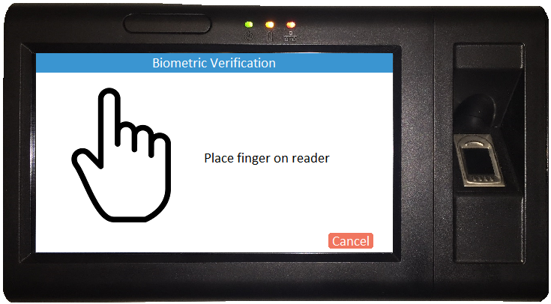
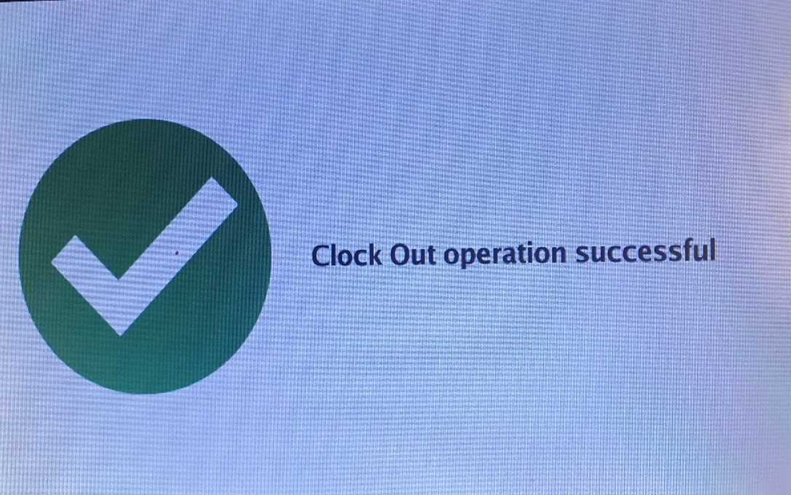
Clocking in and Clocking Out Operations
When you see this screen, you have successfully clocked in/out.
Place your finger on the fingerprint scanner.

Slide 5
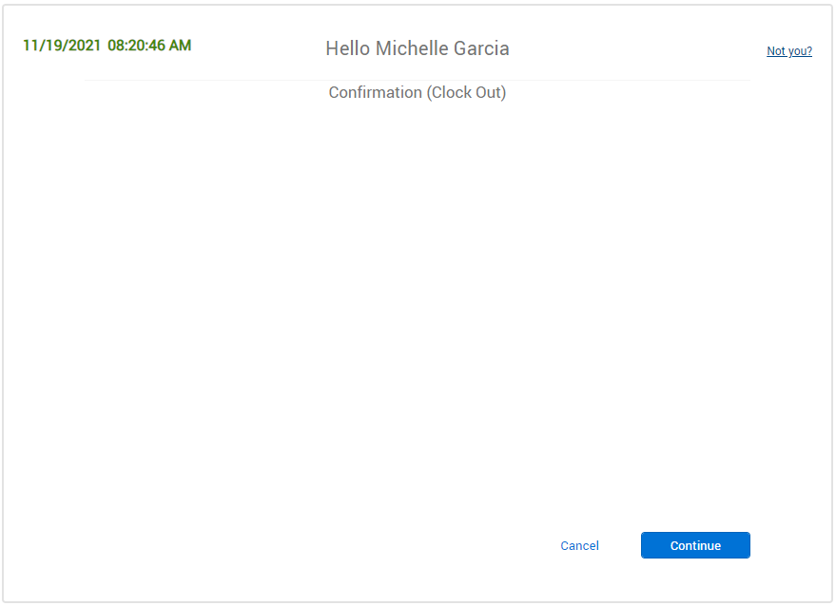
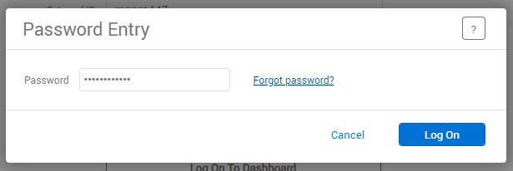
Clock in and Out using Computer
Enter your Password. Same password as your computer credentials. Click Log On.
This is confirming that you are clocking in or out.
Click on Continue.

Slide 6
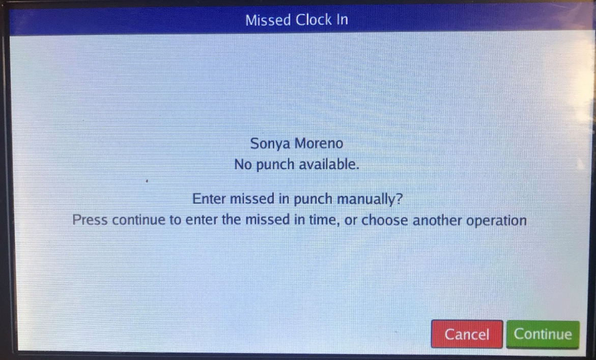
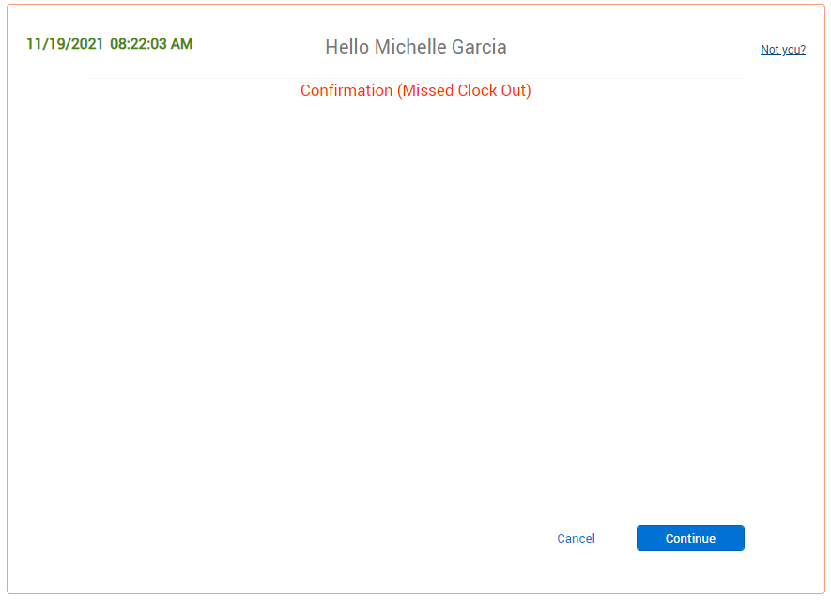
Correcting/Missing punches using Clock
Correcting/Missing punches using Computer
System is letting you know that there is a missed punch – Press Continue
If you get this message, this means you missed a punch and you cannot perform any other actions until it is corrected.
Click Continue.

Slide 7
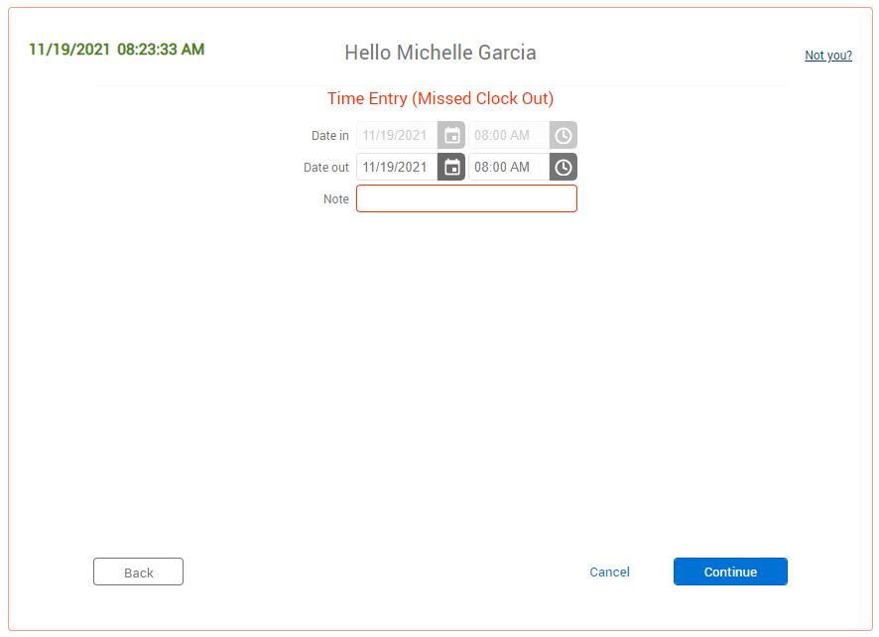
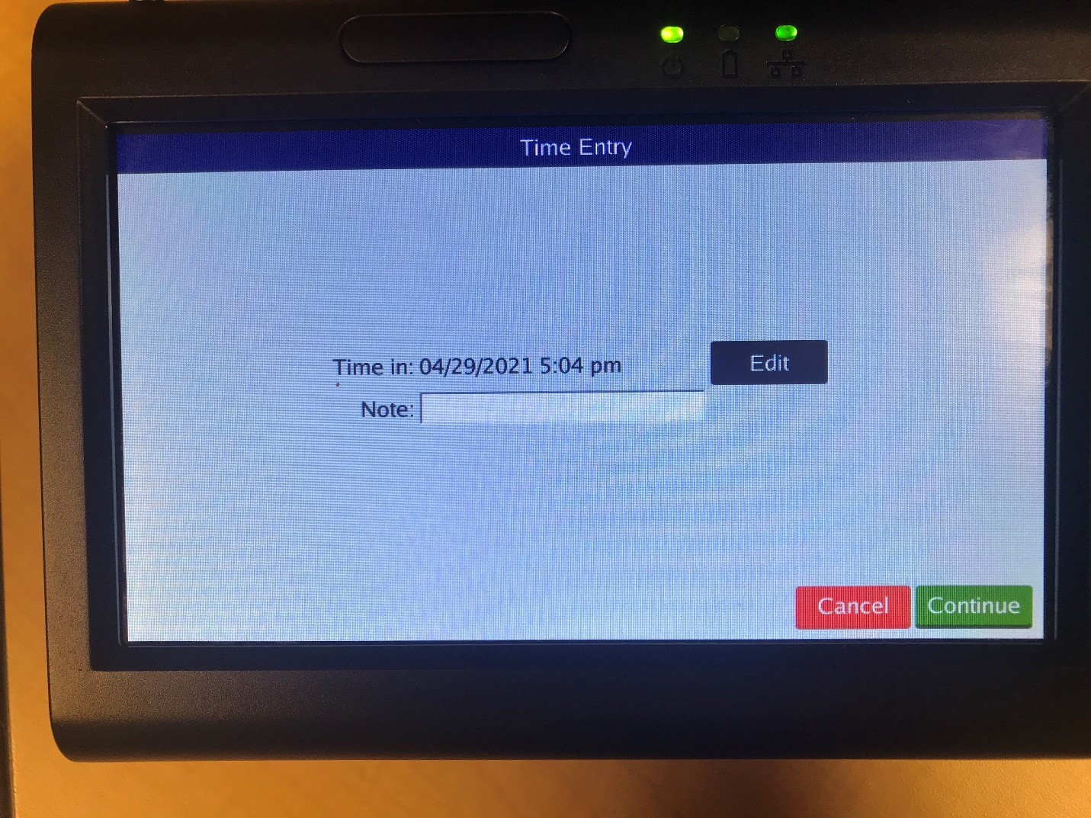
Correcting/Missing punches using Clock
Correcting/Missing punches using Computer
Verify or enter date and time of missed punch. Enter a Note, this is required.
This screen will allow you to correct the missing punch – Press Continue

Slide 8
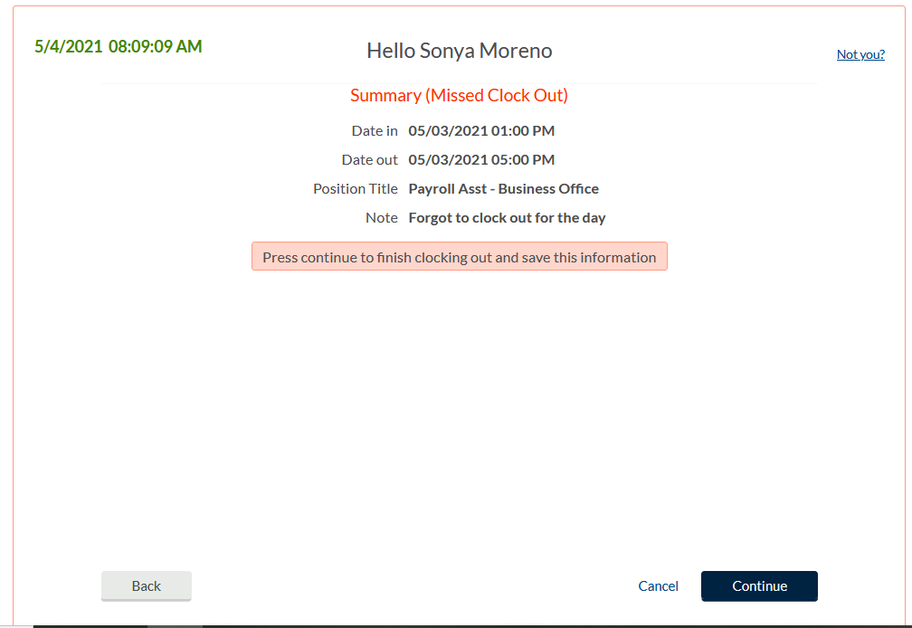
Correcting/Missing punches using
Clock
Correcting/Missing punches using Computer
Summary screen – Verify date, time, and action. If correct, Press Continue
Summary screen - Verify date, time, and action.
If correct, click Continue.

Slide 9
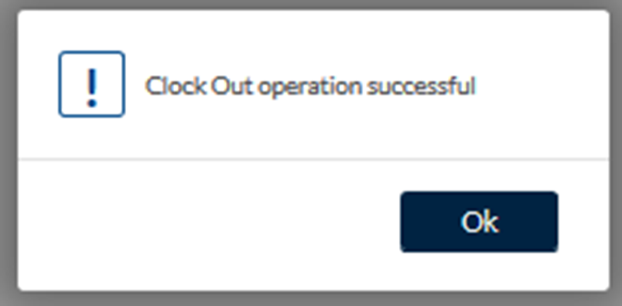
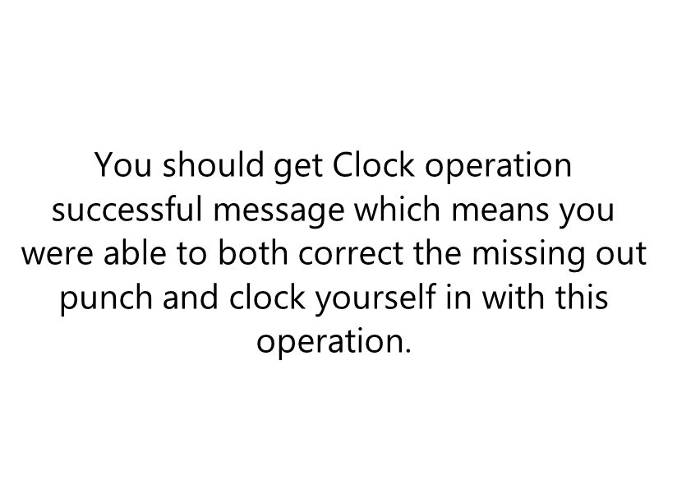
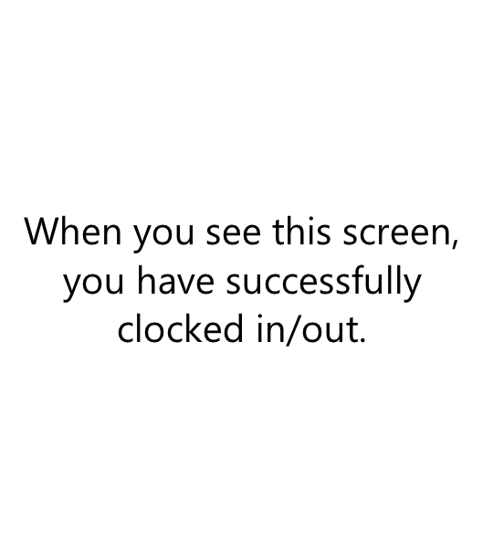
Correcting/Missing punches using
Clock
Correcting/Missing punches using Computer

Slide 10
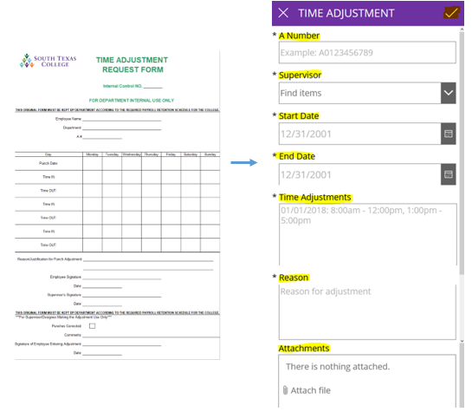
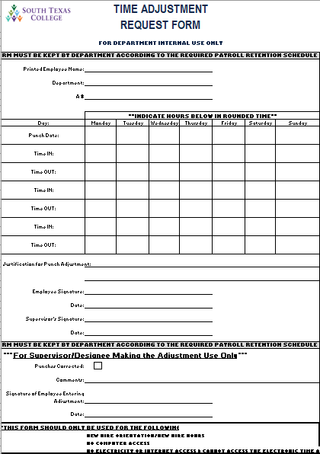
Correct/Revise Punch-Enter Record
If you need to correct a segment or have a missed clock in or out, you must submit an electronic time adjustment (southtexascollege.edu/go/tarf).
If no electricity or internet is available a paper TARF will be accepted.
The electronic TARF is only to be used when you need to submit hours worked in a full segment, such as when working outside of STC premises or traveling for conferences, etc.
Supervisor must make corrections in TCP.

Slide 11
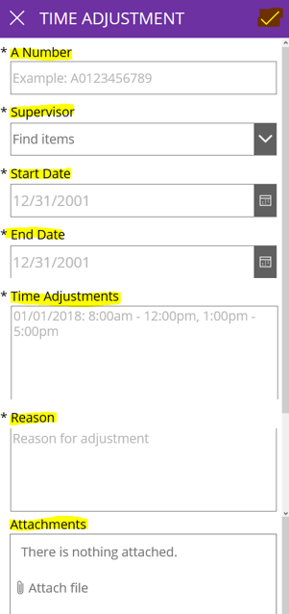
Electronic Time Adjustment Request - PowerApps
This electronic TARF is only to be used when you need to submit hours worked in a full segment, such as when working outside of STC premises or traveling for conferences, etc.
The electronic TARF is the preferred method for submitting time adjustments, unless there is no electricity or internet.
southtexascollege.edu/go/tarf

Slide 12
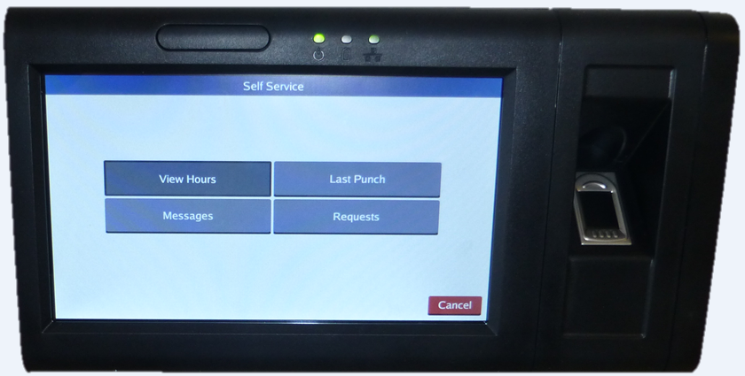
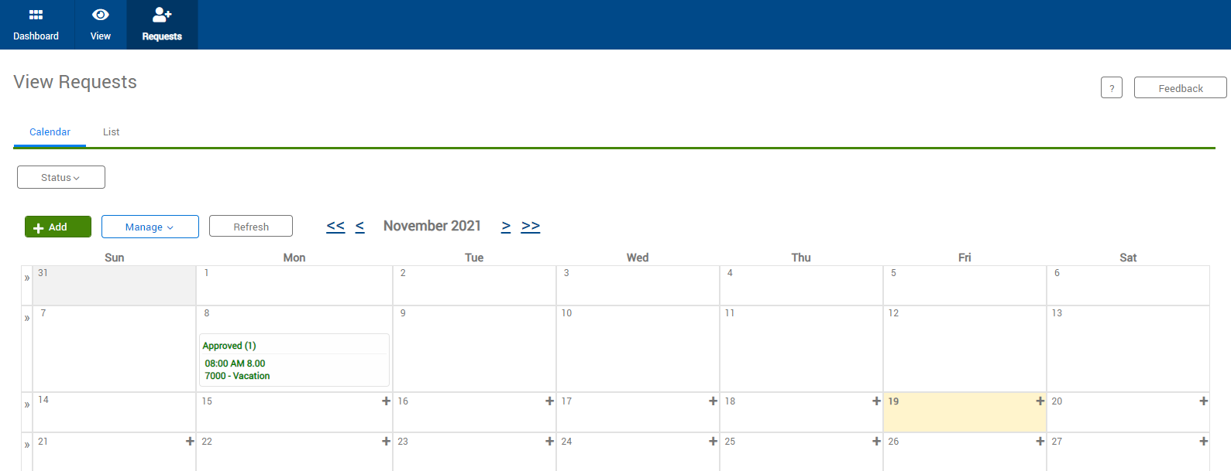
Requesting Leave Using Clock
Request Leave using Computer-Full Time Employee (Exempt & Non-Exempt)
Click on Requests.
Click on Requests, calendar will appear. You can either double click the day you want to request leave for or click on green +Add.

Slide 13
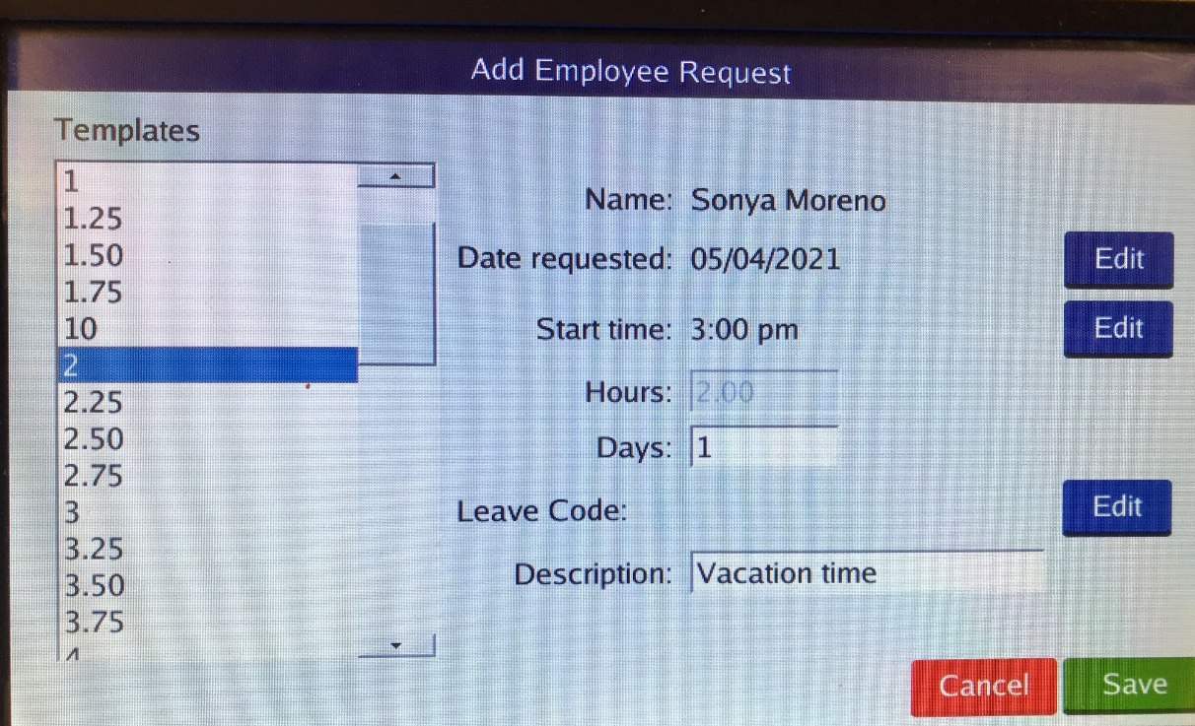
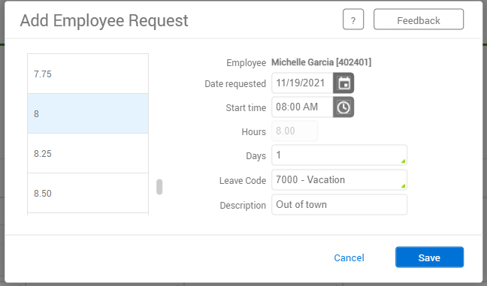
Requesting Leave Using Clock
Request Leave using Computer
Enter date of requested leave, start time (typically 8 am if full day), number of hours for leave, (typically 8 if full day), number of days, choose a leave code from drop down. Enter a brief description. Be sure to choose the correct leave code, as you are responsible for your leave requests.
Using Edit button, enter date for leave requested, start time, and number of hours, or days. Enter brief description, ex. Vacation day. Then for Leave code line, click on blue Edit button.

Slide 14
Request Leave using Computer-Full Time Employee (Exempt & Non-Exempt)
Example: In month of February, an employee wants to request Vacation Leave for June. However, they haven’t accrued enough leave as of February to request the amount of vacation they want to take in June. Since TCP is linked to Banner, employees are unable to request leave based on future leave earnings.
The employee will notify the supervisor that they are requesting leave in June, the supervisor will input into TCP and have those days locked for them as vacation.

Slide 15
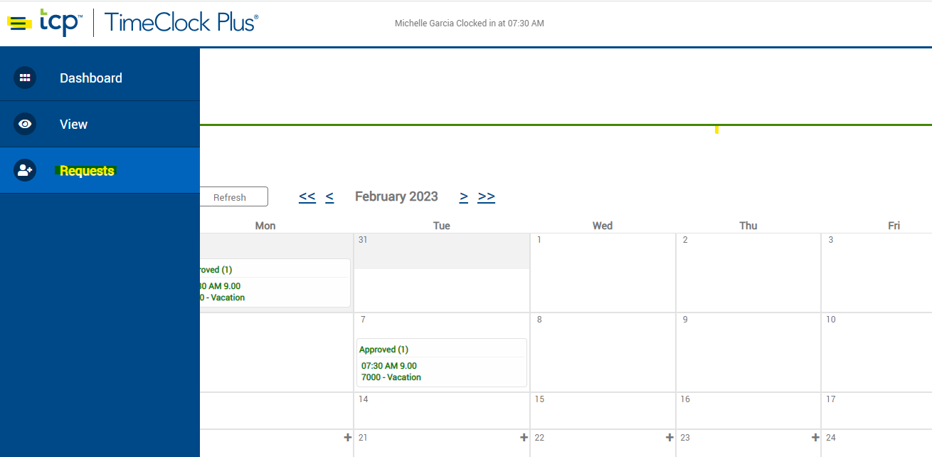
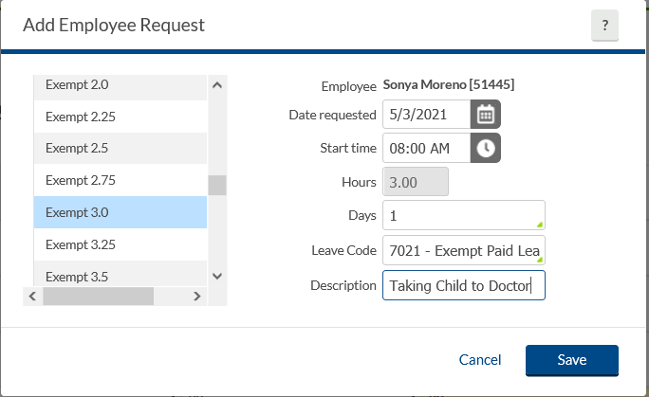
Exempt Employees ONLY
If you are an EXEMPT employee and if you are out of the office for a PARTIAL DAY- (Less than 4 hours)
Report the absence using the Exempt-Paid Leave code
Select the REQUEST Tab
Click on the day you want to request partial leave, enter the start time & number of hours, use the leave code: EXEMPT-Paid Leave enter a brief description, & save.
**Keep in mind this will not be reduced from your leave its just for reporting purposes.**

Slide 16
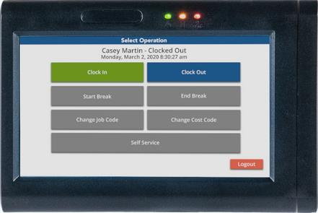
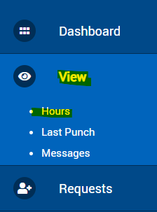
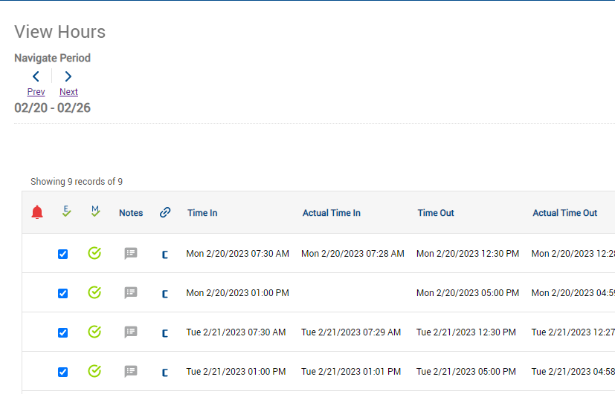
Verifying Time Using Clock
Verifying Time Using Computer
Log into the clock. This will take you to the “Select Operation” screen.
From the “Select Operation” screen, press Self Service.
Examine the time information. If everything is correct, press the checkbox in the Aprv column next to the segment. Once you have verified your time click Close.
Employees should review their timecards daily. After logging in, click on View, Hours, then choose the dates you want to review & verify. If correct, click the column under E & checkmark indicating Employee approval.

Slide 17
Supervisor Role – Deleting a Requested Leave
The Supervisor may delete employee’s requested/approved leave upon the request of the employee by logging into TCP. Select Tools → Requests → Request Manager
If you are unable to locate the request make sure you have included the pending & approved requests.
Click once on the request that is needing to be deleted, right click then click on Delete. This will delete the request on the calendar as well as the employee’s timecard.

Slide 18
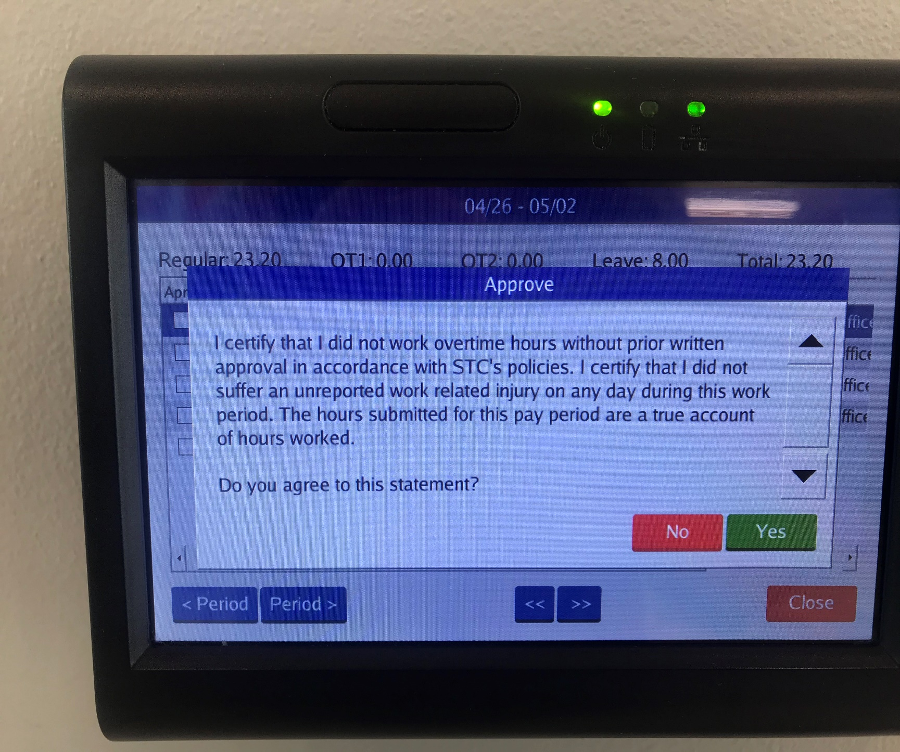
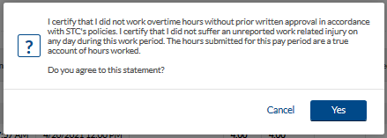
Verifying Time Using Clock
Verifying Time Using Computer
Every time you approve your hours, you will receive this notice.
If you agree to this statement, click on Yes.
Each time you approve your hours, you will receive this notice. It is to certify that you did not work overtime hours without prior written approval and that you did not suffer an unreported work related injury on any day during this work period. If you agree to this statement, click on Yes.

Slide 19
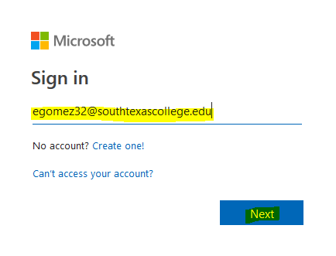
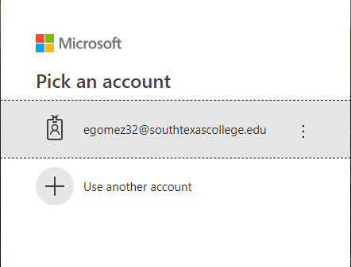
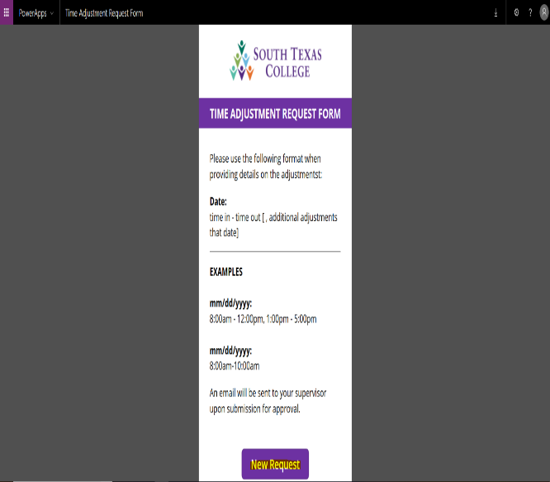
Time Adjustment Request Form
Log In to: www.southtexascollege.edu/go/tarf
Using your same credentials as Jagnet and then click Next or select your account.
When you see the PowerApps Time Adjustment Request Form, click on New Request.
Enter the Required Fields: Enter your A#, Supervisor Name, Start Date (the day or days you need the adjustment for), End Date, Time Adjustment (times you need in your timecard to be fixed or added), Reason (justification of why time adjustment is needed). Attachments are optional but you can use this section to upload any conference schedule that you may have attended. Once information is complete, click submit. Your supervisor will receive an e-mail notification to process your request in TimeClock Plus.

Slide 20
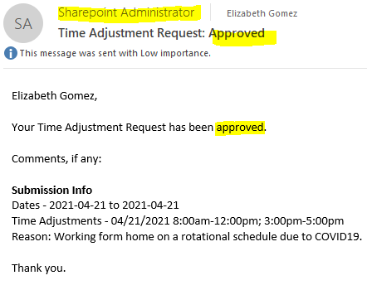
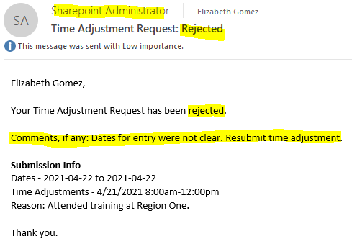
Time Adjustment Request Form
Confirmation Email
You will receive an email confirmation from Sharepoint Administrator notifying you that your time adjustment has been either approved or rejected by your supervisor. Please see below examples of Approved and Rejected.
If your time adjustment request is approved, it is your responsibility to ensure it is posted in TimeClock Plus before verifying your timecard.
If your time adjustment request is rejected, check the comments if provided in the email you received from SharePoint Administrator or inquire with your supervisor the reason why it was rejected. If correction is needed, you will need to re-submit a new electronic TARF.

Slide 21
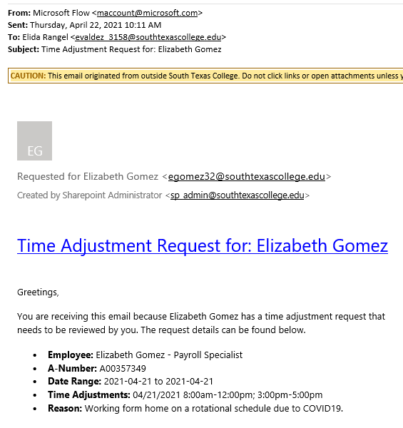
Time Adjustment Request – Adding / Correcting Hours
Supervisor will receive request from the employee via email, the email will be delivered by Microsoft Flow, supervisor will review, and if approved, supervisor will need to enter into TimeClock Plus.
*REMINDER Payroll Record Retention: Current fiscal year + 3 years for all employees.

Slide 22
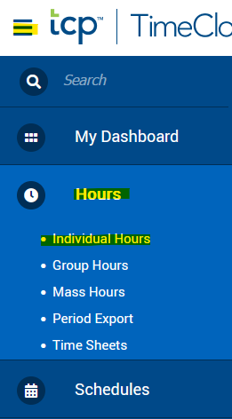
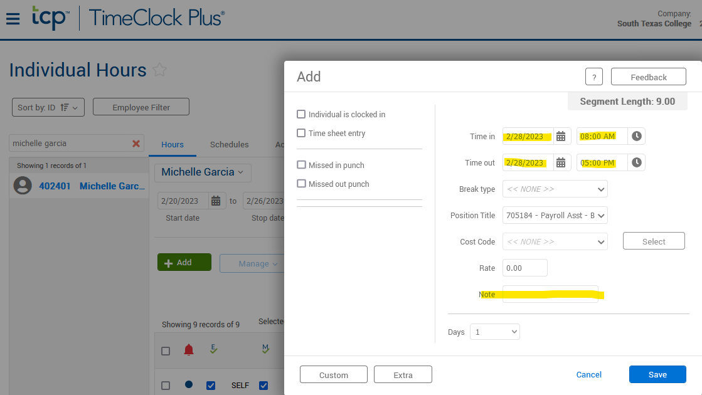
Time Adjustment Request – Adding / Correcting Hours
Go to Hours, Individual Hours, find the employee, click on the segment that needs adding/correcting.
Click on green +Add button:
The supervisor will enter the working hours and they will include the note provided by the employee.
Then click Save.
Do not Click on Time Sheet entry Box – this section is only to be used by Payroll when applying mass punches.

Slide 23
Review & Verify Timecard Daily
Supervisors and non-exempt employees please get in the practice of reviewing and verifying your timecards on a weekly basis for accurate payroll processing.
In TimeClock Plus, we are able to review and verify hours on a daily/weekly basis rather than waiting for the end of the pay period.
This is an advantage toward accurate payroll processing.
If timecard verification was not done before pay period locking; both non-exempt employee and supervisor will need to print and sign off timecard and have it kept within your department for current fiscal year + 3 years for all employees.

Slide 24
Best Practices
Use the timeclock closest to your work area/building, for clocking in and out.
Use the Computer for reviewing and verifying timecards.
Use the Computer for requesting leave.
Review and approve your hours on a daily basis.
Become familiar with the software so that it can be utilized to the best capacity.
Of course, same fraud awareness carries over. Do not share passwords, do use the clock in your assigned area, do not abuse leave, do not abuse working hours, do not overuse the ability to correct/revise punches.
Any reports of suspicious abuse will be investigated.
Visit website https://finance.southtexascollege.edu/businessoffice/timeclock.html
Presentations and Training Videos

Slide 25
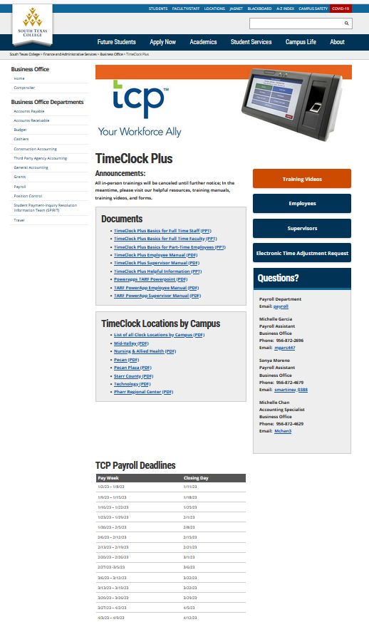

Slide 26
Thank you! Questions contact us @ mgarc447@southtexascollege.edu smartinez_0388@southtexascollege.edu payroll@southtexascollege.edu Michelle Garcia, TCP Admin - Payroll Assistant Sonya Moreno, Payroll Assistant

